Slide 1



Power Platform Governance Center of Excellence (CoE)

Slide 2
Disclaimer

Slide 3
What is a Centre of Excellence?
Strategy
Nurture
Governance and administration
Training
Design and build
Support
Center of Excellence (CoE) is a team, shared facility or entity that provides leadership, best practices, research, support and/or training for a focus area
It is a coordinating function that often sits between IT and organizational groups / business groups.
Helps form a strategy for adopting & supporting Apps.
Establishes the guard-rails, best practices & standard to be followed.
Designed to drive innovation and improvement with longevity.
Ensures consistency & defines standards to be followed.

Slide 4
Operating models
Centralised
Hybrid / Matrix
Decentralised / Federated
Controls the entire initiative.
All stakeholders connect and devise common strategy, process, standards and implementation methodology.
All solutions monitored centrally.
Re-usability high as common components is built, revised & published regularly.
Efficiency High due to central management of deployment, reusable components.
Best suited for organizations running out of 1 or few locations.
Hub & Spoke model.
Central COE with sub-CoE in different Geos or teams.
Sub-COE follows high Level strategy as laid by Central COE, but drives & monitors solutions locally.
Re-usability medium to high, as they have visibility to resources from central team.
Efficiency may not be as high as centralized model. But this model has better control for local requests.
Best suited for Geographically distributed organizations.
COE teams distributed across organization.
Individual teams build their own strategy and solutions as per their needs.
Re-usability low as each team builds their own solutions.
Efficiency low as various teams work in silos.
Best suited for organizations where various teams plan to start small or have very different priorities

Slide 5
Involvement with business
Gatekeeper
Coach
End-to-end delivery
Not involved in app development
Ensures processes are followed and guides accordingly
Led by a lean team primarily ensuring process and procedure is followed
Provides expert advice to teams, guiding them in building own solutions
Understands the challenges and recommends the best possible solution
Leverages champions network
Delivers end-to-end solution
Understands requirements, designs & builds the right solution
Fully fledged development team: solution architects and developers

Slide 6
Establishing a Centre of Excellence
A key principle is to clarify why you’re setting up a CoE, what it aims to accomplish and the key business outcomes you hope to achieve.
Designed to drive innovation and improvement, as a central function it can break down geographic and organisational silos – a powerful way for organisations to align around business goals rather than individual department metrics.

Slide 7
Overview of Center of Excellence Starter Kit

Slide 8
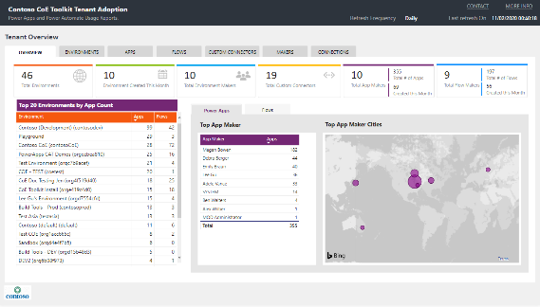
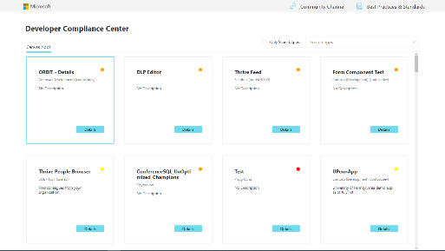
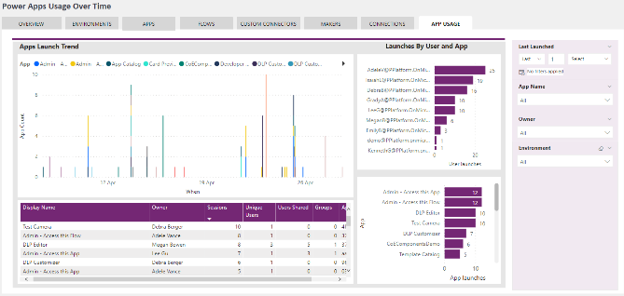
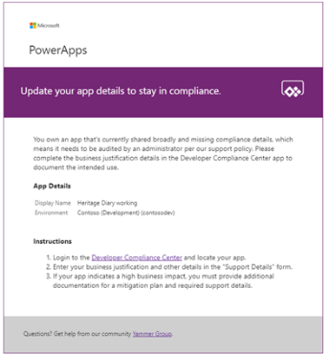
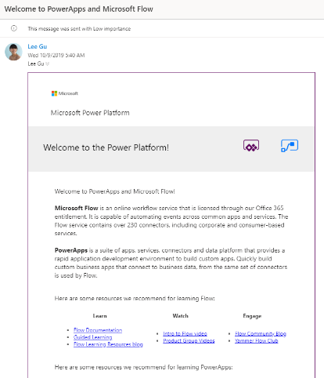
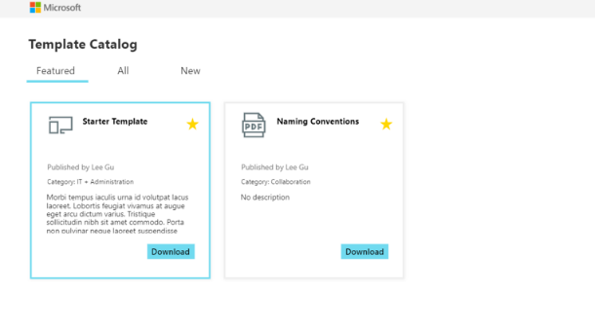
What is Center of Excellence Starter Kit
Existing offering: Admin Centre capabilities Extensibility via Connectors
Templates: A templatized implementation of best practices The CoE Starter Kit is a collection of components and tools designed to help you get started with developing a strategy for adopting and supporting the Power Platform.
https://aka.ms/coestarterkit
Notes:
A CoE requires much more than the tools alone; it requires people, communication, and defined requirements and processes and likely a cultural change. However, the right tools can help you get started with planning your strategy of adopting the platform at scale. The CoE Starter Kit is a set of components (apps, flows, dashboards) that represent a templatized implementation of best practises – it’s owned by my team and influenced by what we’ve seen in the wild, what we’ve seen successful customers implement. Adopting it can give you the ability to better administer the platform with a dashboard that gives you full visibility, ability to govern with a sample audit process, ability to nurture with template catalog to share best practises and welcome email to welcome new makers.
It can help with the how, once you’ve established the what and why.

Slide 9
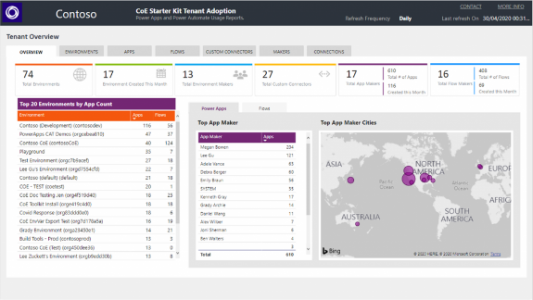
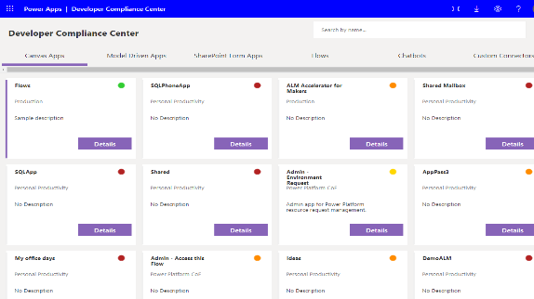
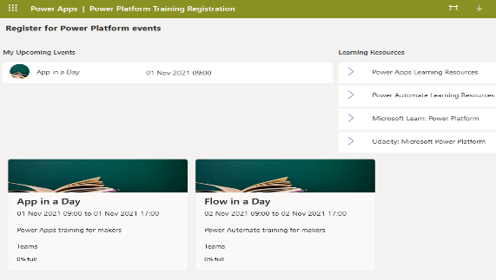
Building Blocks
Admin
Gain Insights into your Power Platform adoption
Governance
Establish Audit, Compliance and Archive processes
Nurture
Accelerate your adoption with a thriving community
Audit Log
Collect Power Platform events from Office 365 Audit Log

Slide 10
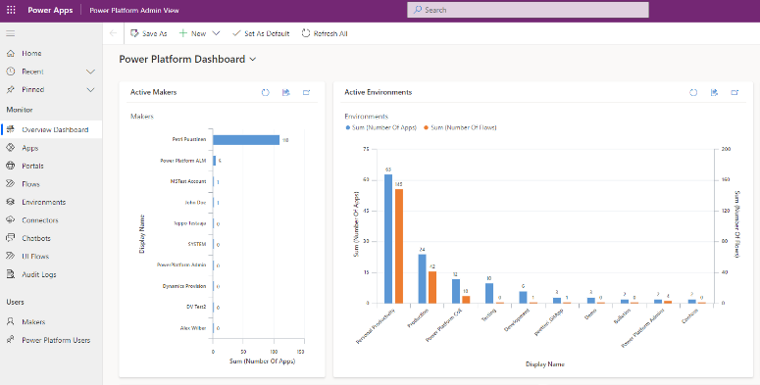
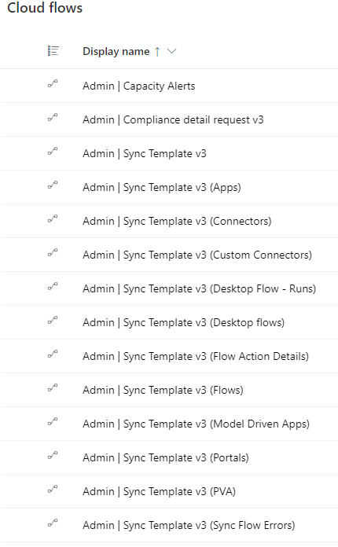
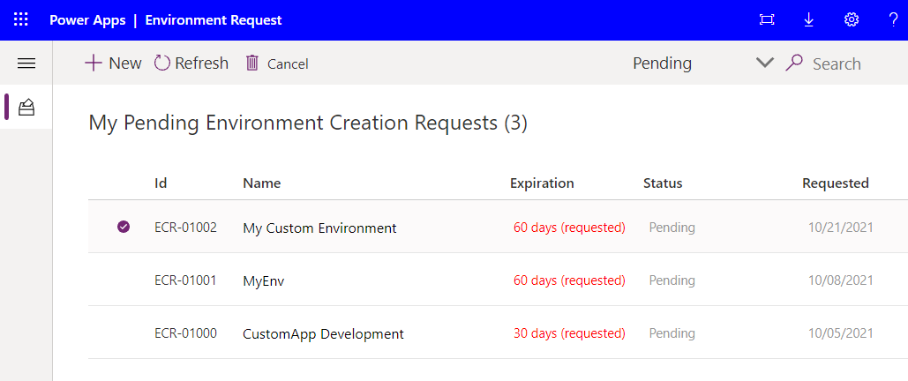
Admin Components - Core
CoE Starter Kit Building Blocks
These components provide the core to get started with setting up a CoE – including Sync Flows to gather information about all your resources into Dataverse tables and build Apps and reports on top of that to help you get more visibility of what apps, flows and makers are in your environment.
Core Components contains mainly assets relevant to admins but also provides foundation for some of the other CoE components like Governance and Nurture

Slide 11
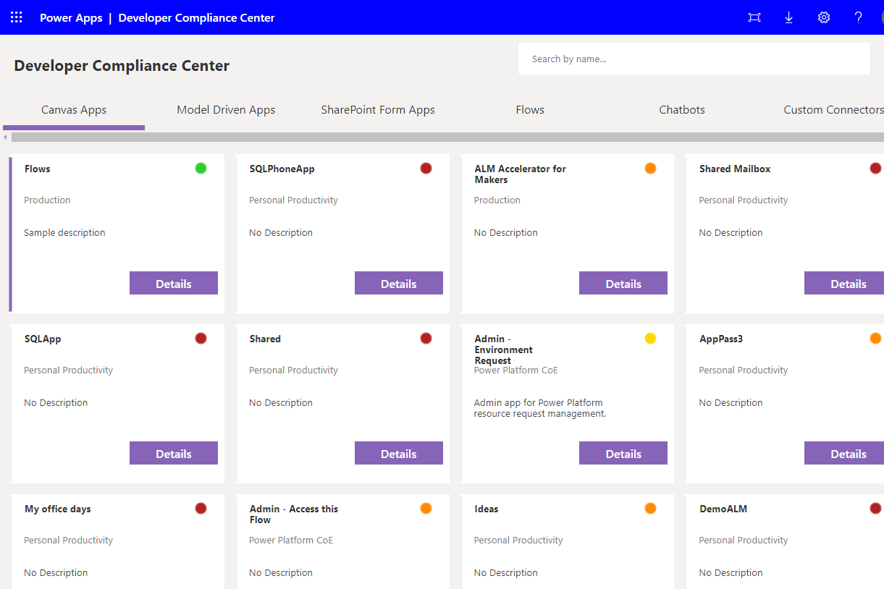
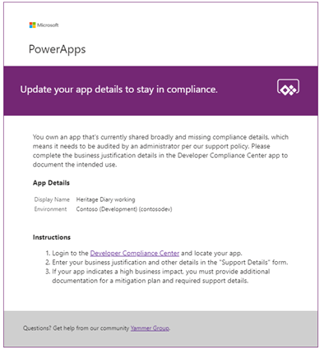
Governance Components – Audit & Compliance
CoE Starter Kit Building Blocks
After you've become familiar with your environment and resources, you might start thinking about audit and compliance processes for your apps. You might want to gather additional information about your apps from your makers, or audit specific connectors or app usage. The apps and flows that are part of this solution help you get started.

Slide 12
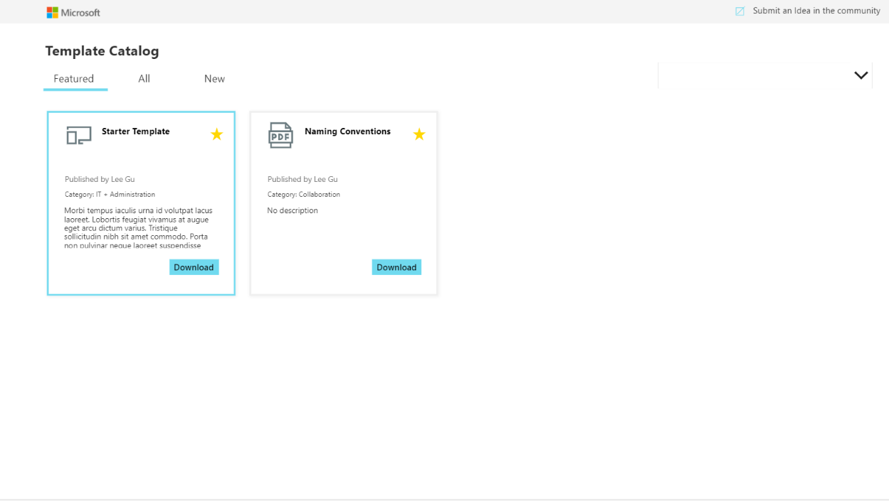

Nurture Components - Learning
CoE Starter Kit Building Blocks
An essential part of establishing a CoE is nurturing your makers and an internal community. You will want to share best practices and templates and onboard new makers – the assets part of this solution can help develop a strategy for this motion. The Nurture Components solution contains assets relevant to everyone in the organization, admins, makers as well as end users of apps and flows.

Slide 13
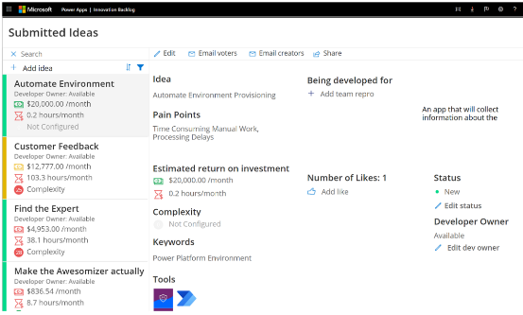
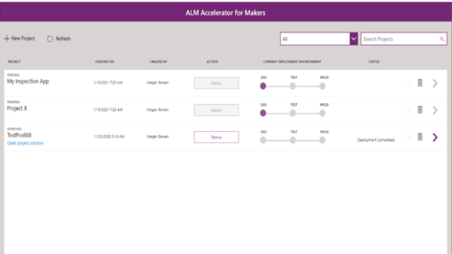
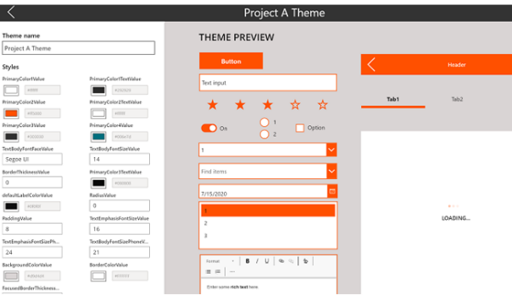
Standalone Add-ons
Innovation Backlog
Submit ideas for apps and flows that need building
ALM
Implement Application Lifecycle Management patterns and practices for source control
Theming
Create, manage and share enterprise branded themes

Slide 14

Innovation Backlog - Ideas
CoE Starter Kit Standalone Add-ons
Use the Innovation Backlog app to ask users to submit ideas for apps and flows that need building and describe pain points with the current process. As users describe the process, they will provide information about personas involved, tools used, and measures for improvement. This information is then used to calculate an ROI and complexity score
The theming components solution doesn't have a dependency on other components of the CoE Starter Kit, so it can be used independently.

Slide 15
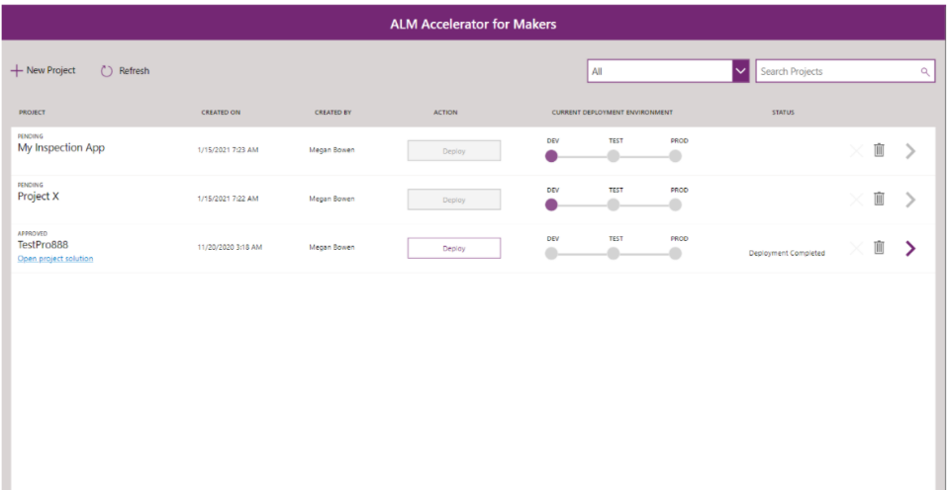
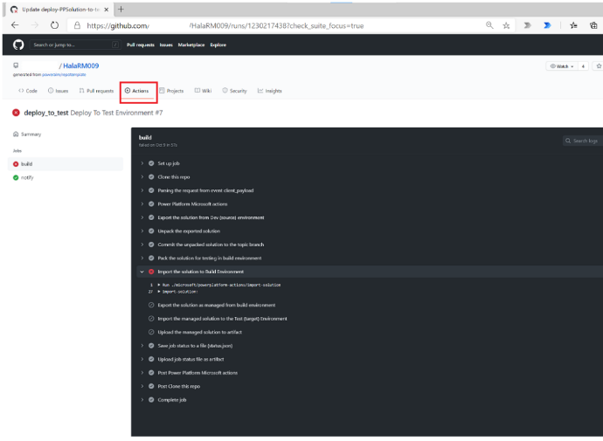
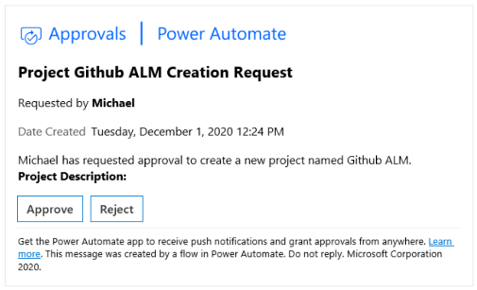
ALM Accelerator for Makers
CoE Starter Kit Standalone Add-ons
Use the ALM Accelerator for Makers app to follow ALM patterns and practices for source control, and move your solutions from development to test to production environments by using GitHub.
Makers can use the ALM Accelerator for Makers app to view all their projects, and deploy their work-in-progress or completed solution to a test or production environment. After a new project has been created and approved, makers can go to make.powerapps.com to build and create assets—such as apps, flows, and tables—in a solution that has been created for them.

Slide 16
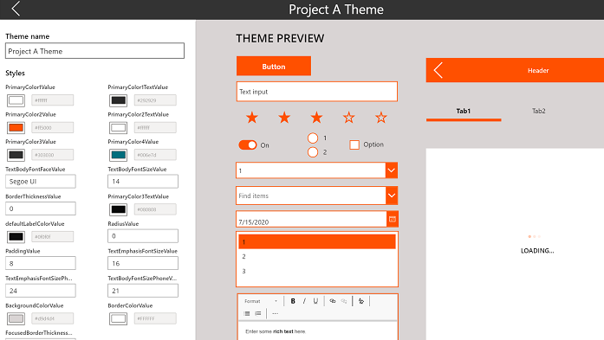
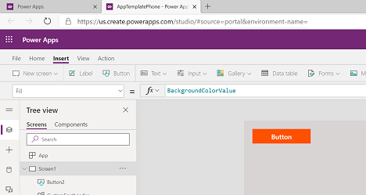
Theming Components - Branding
CoE Starter Kit Standalone Add-ons
You use theming components to create, manage, and share themes for canvas apps. A theme contains a collection of styles that define multiple design properties for controls and components such as colors, fonts, and borders. These styles are then applied automatically to controls and components when makers use the themed template app to create a new app.
The theming components solution doesn't have a dependency on other components of the CoE Starter Kit, so it can be used independently.

Slide 17
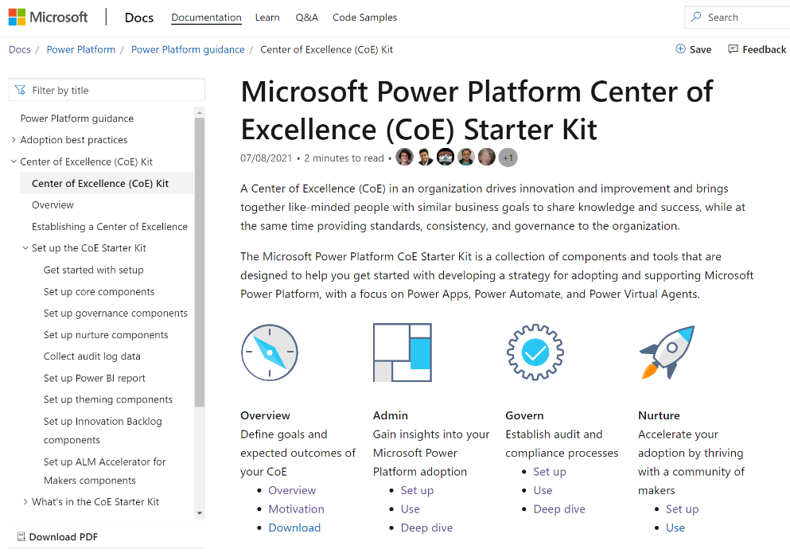
CoE Starter Kit - Documentation
Center of Excellence Starter Kit documentation can be found from
https://docs.microsoft.com/en-us/power-platform/guidance/coe/starter-kit
Requirements and limitations
Comparison of different CoE versions (Production / Dataverse for Teams)
Setup and how to use instructions
Guidelines how update and extend the toolkit
Detailed documentation of each component like individual Flows, Apps etc. of the CoE

Slide 18
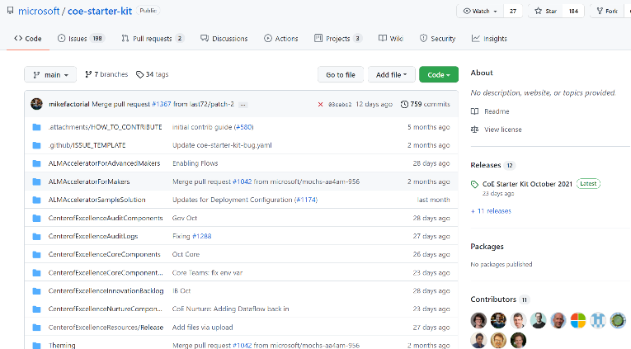
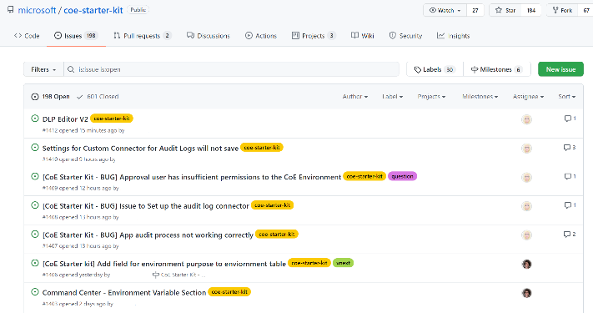
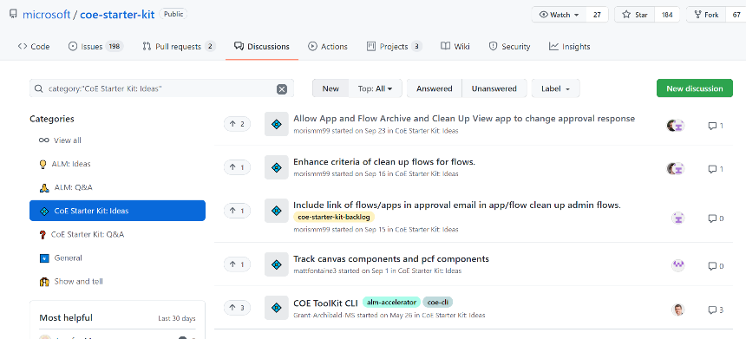
CoE Starter Kit – GitHub Repo
Center of Excellence Starter Kit GitHub Repository can be found from
https://github.com/microsoft/coe-starter-kit
Download latest and previous version of CoE
Report possible issues and get support (not officially supported by MS)
Request new features
Have a discussions and share ideas
Contribute

Slide 19
CoE Starter Kit – Extend
When you're ready to extend the CoE Starter Kit with your own ideas, you'll do so by making modifications to the solution components in your own unmanaged solution
Choose components from the CoE Starter Kit to add to your new solution
Extend the CoE Starter Kit by making modifications to the solution components in the context of your new unmanaged solution
Deploy your solution to test and production. We recommend making modifications and installing updates pushed by our team to the solution in a development environment dedicated to this kit and hosting a production environment that has the real data. If data is being accessed and contributed by other users, it's a good idea to have separate development, test, and production environments.

Slide 20
Production vs Dataverse for Teams environment
Feature | Dataverse for Teams environment | Production environment
Syncing inventory to Dataverse tables | Yes, will require a Power Automate Per User/Per Flow license due to action request limits and pagination settings | Yes, will require a Power Automate Per User/Per Flow license due to action request limits and pagination settings
Collecting telemetry information from the Audit Log | No | Yes
Power Platform Admin View to view and filter resources | Canvas App | Model Driven App
Power BI Dashboard | Yes | Yes
Canvas Apps part of Core Components (DLP Editor, Set App and Flow Permission Apps) | Yes | Yes
Apps and Flows part of Governance Components | Yes | Yes
Apps and Flows part of Nurture Components | Yes | Yes
Sharing the Developer Compliance Center with makers | Share with colleagues who have a Microsoft 365 license in Teams | Sharing requires users to have a Power Apps Per User or Per App License
Sharing the App Catalog app | Share with colleagues who have a Microsoft 365 license in Teams | Sharing requires users to have a Power Apps Per User or Per App License
Sharing the Training in a day app | Share with colleagues who have a Microsoft 365 license in Teams | Sharing requires users to have a Power Apps Per User or Per App License

Slide 21
Core Components Deep Dive

Slide 22

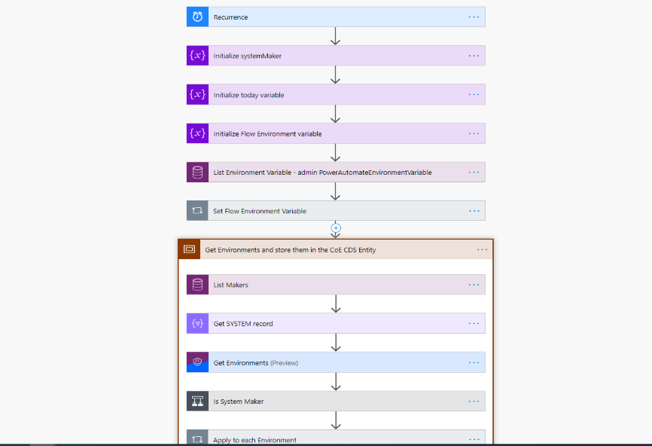
Sync Templates
Flows
Sync Template (resources) runs daily overnight
Gets Apps / Flows / Connectors per Environment
Updates Dataverse tables

Slide 23
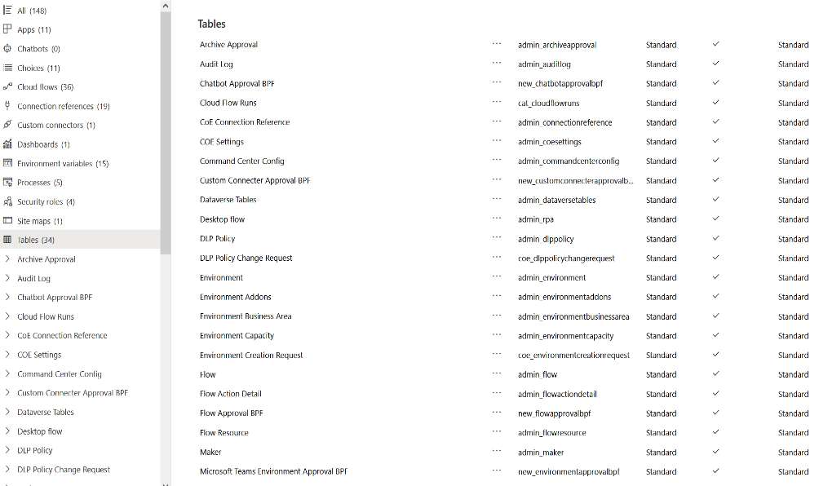
Dataverse Tables
The Sync Flows of the CoE Starter Kit sync your tenant resources to the following Dataverse tables.
All tables provide information about created by/on and modified by/on, in addition to resource-specific information.

Slide 24
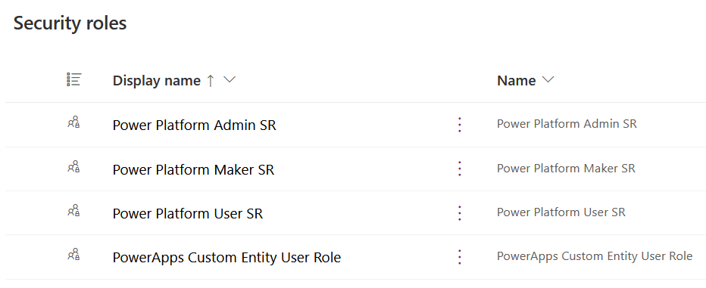
Security Roles
Power Platform Admin SR
Gives full access to create, read, write, and delete operations on the custom tables.
Power Platform Maker SR
Gives read and write access to the custom tables (environments, apps, and so on).
Power Platform User SR
Gives read-only access to the resources in the custom tables.
PowerApps Custom Entity User Role
Gives read-only access to PowerApps App table

Slide 25
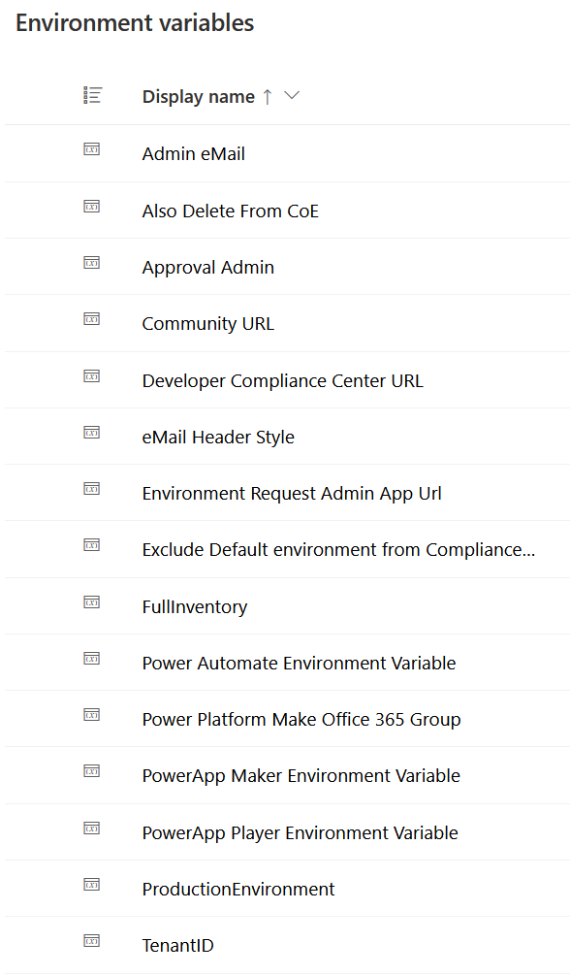
Environment Variables
Core Component contains following environment variables which are used to define and control certain CoE functionalities and settings. Few examples are:
Admin eMail - Email address used in flows to send notifications to admins; this should be either your email address or a distribution list
Power Automate environment variable - The URL used by flow for your region
Also Delete from CoE - Recommend Yes here to delete objects from the CoE inventory when they are deleted from the tenant. No will keep a record that an app or flow existed in the past
Community URL - Link to your internal Microsoft Power Platform community (for example, Yammer or Teams).
Some can be set during the solution import, and some might be needed to update afterwards depending which CoE components will be used
Environment variables can be set (not update) in new solution view, in Default Solution or using Admin – Command Center canvas app
https://docs.microsoft.com/en-us/power-platform/guidance/coe/setup-core-components#update-environment-variables

Slide 26
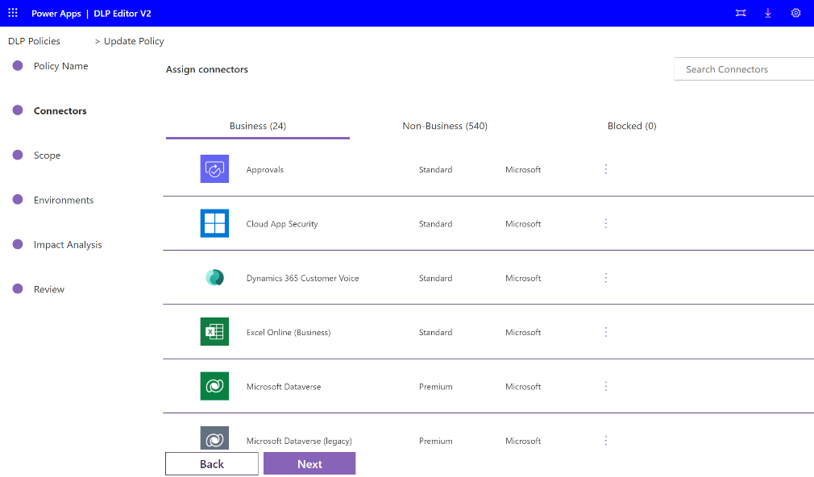
DLP Editor V2
Canvas App
Reads and updates Data Loss Prevention (DLP) policies while showing a list of apps and flows that are impacted by the policy configurations.
Use this app to:
Make changes to DLP policies
See what impact each change will have
Mitigate the risk by contacting makers

Slide 27
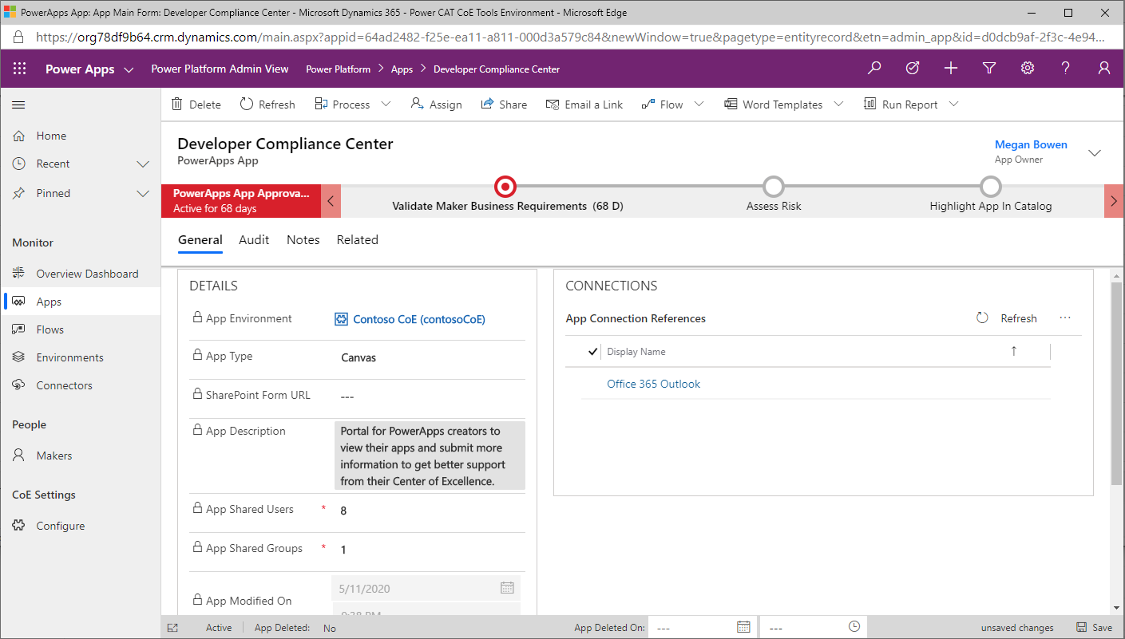
Power Platform Admin View
Model-driven App
Provides an interface used to browse items in Dataverse custom tables. It provides access to views and forms for the custom tables in the solution.
Use this app to:
Get a quick overview of resources in your tenant
Learn about your makers, connectors, apps, and flows
Find out who apps are shared with
Add additional information, such as notes and risk assessments, to your resources
Set approved capacity for environments, and see capacity and add-on information per environment
Complete app audits

Slide 28
Compliance Request Flow
Flow
Sends an email to users who have PowerApps apps in the tenant who are not compliant with specific thresholds:
The app is shared with > 20 Users or at least 1 group and the business justification details have not been provided.
The app has business justification details provided but has not been published in 60 days or is missing a description.
The app has business justification details provided and has indicated high business impact, and has not submitted a mitigation plan to the attachments field.
The Flow has a template you can customize in the email

Slide 29
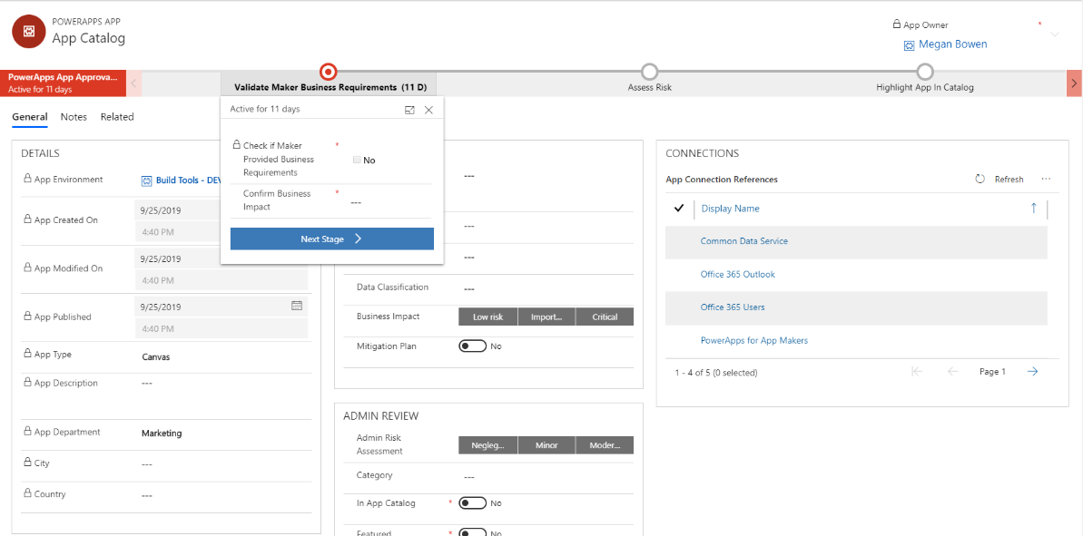
Auditing Process
Business Process Flow
Audit Process to
Validate maker business requirements
Publish the App to the App Catalog

Slide 30
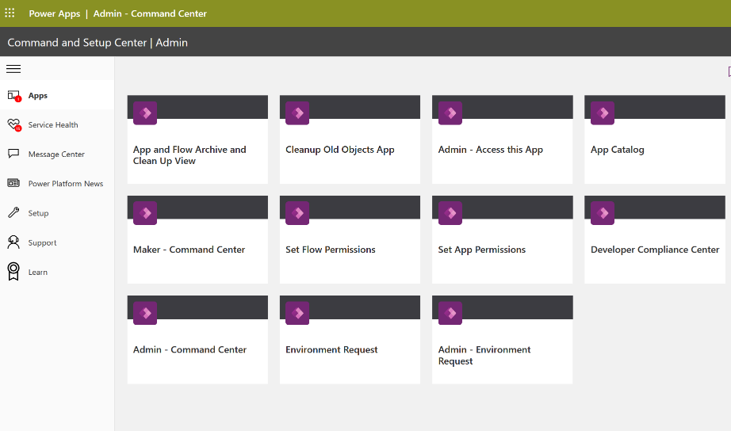
Admin – Command Center
Canvas App
Used by admins as a starting point to launch other apps in the CoE Starter Kit and review content relevant to admins.
Use this app to:
Launch CoE Starter Kit apps and other bookmarks
Review CoE Starter Kit service health by checking sync flows that have recently failed
Update environment variables used in the CoE Starter Kit
View Microsoft 365 Message Center news related to Microsoft Power Platform
Download the latest CoE Starter Kit version and raise support tickets with the team
Launch Microsoft Learn learning paths to learn more about Microsoft Power Platform
Launch the latest posts of the Power Apps, Power Automate, Power BI and Power Virtual Agent blogs

Slide 31
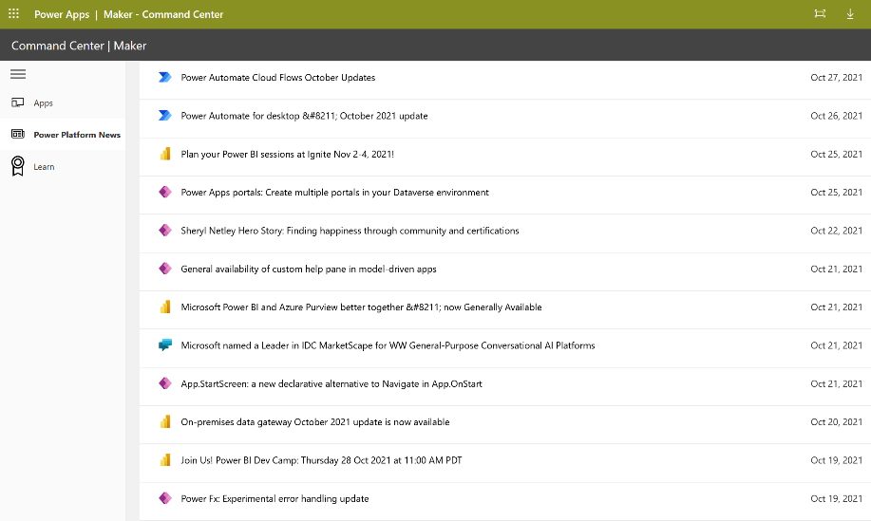
Maker - Command Center
Canvas App
Used by makers as a starting point to launch apps admins have published using Admin – Command Center app which are relevant to makers like App Catalog and Environment Request
Use this app to:
Launch CoE Starter Kit apps and other bookmarks published by admins
Launch Microsoft Learn learning paths to learn more about Microsoft Power Platform
Launch the latest posts of the Power Apps, Power Automate, Power BI and Power Virtual Agent blogs

Slide 32
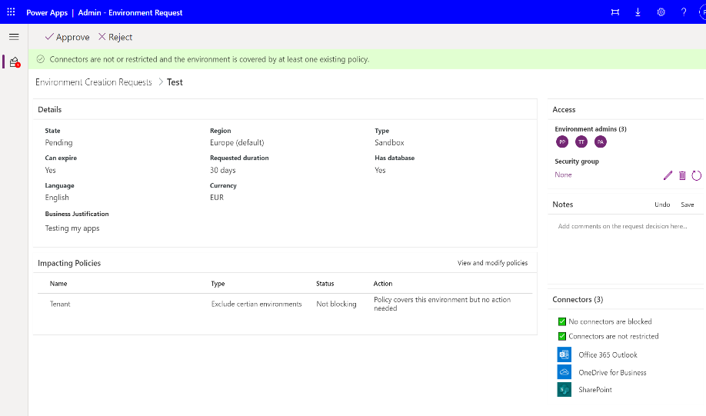
Admin – Environment Request
Canvas App
Used by admins to view and approve/reject requests to create or modify Power Platform Environments
Supports environment creation requests and changes to DLP policies are logged in the DLP Policy Change Request table.
Use this app to:
View all Environment Creation Requests in detail.
Approve or reject Environment Creation Requests.
View if connectors will be blocked or restricted by existing or modified DLP Policies. Modifications made in the app will update those Policies.

Slide 33
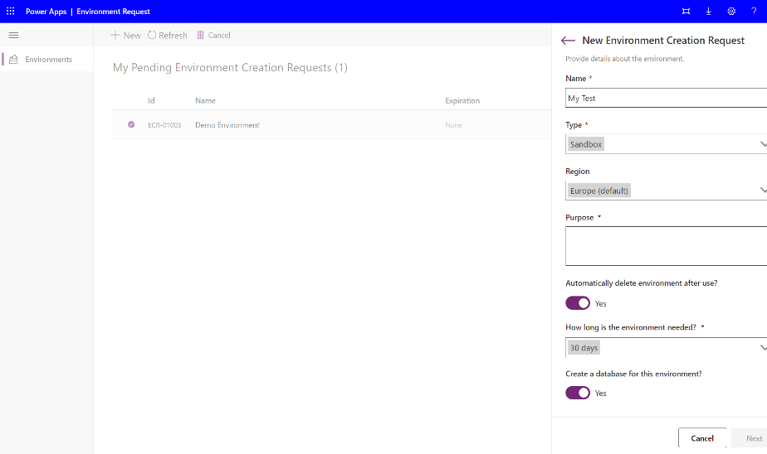
Environment Request
Canvas App
Designed to easily submit Power Platform Environment requests
Use this app to:
Submit new Environment Creation Requests
View existing requests in any state that was submitted. Expiration timeline and link to the Live environments can be found here

Slide 34
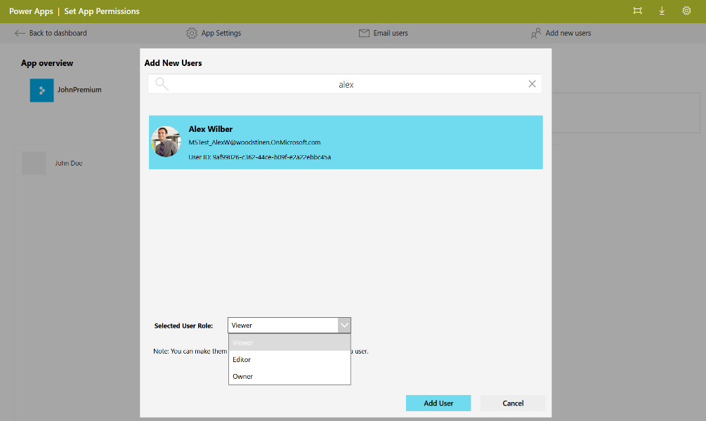
Set App Permissions
Canvas App
Set App Permissions is a canvas app that an admin can use to discover apps by app name, environment, or owner name, and to change app permissions.
Use this app to:
Set a new app owner
Add new viewers and editors
Remove app permissions
Change app permissions from editors to viewers or viewers to editors

Slide 35
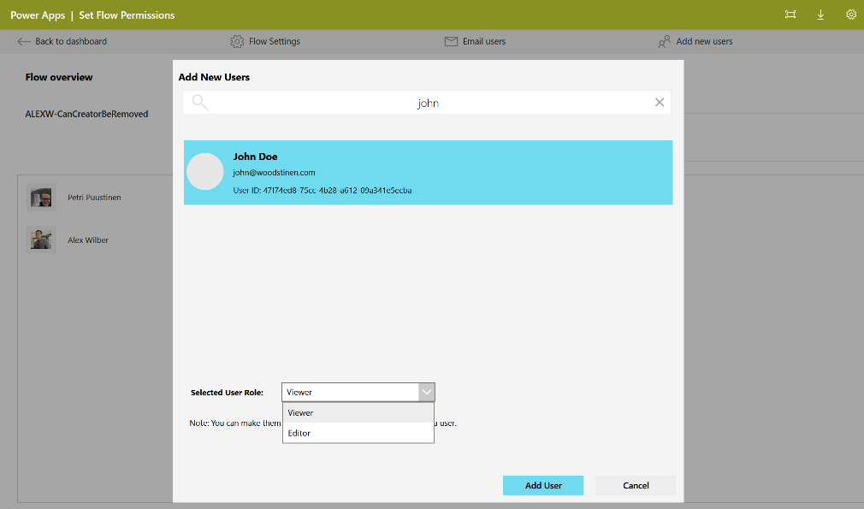
Set Flow Permissions
Canvas App
Similar to Set App Permissions, Set Flow Permissions is a canvas app that admins can use to discover flows by flow name, environment, or owner name.
Use this app to:
Add new viewers and editors
Remove flow permissions
Note that the primary owner (CreatedBy) of a flow can't be changed

Slide 36

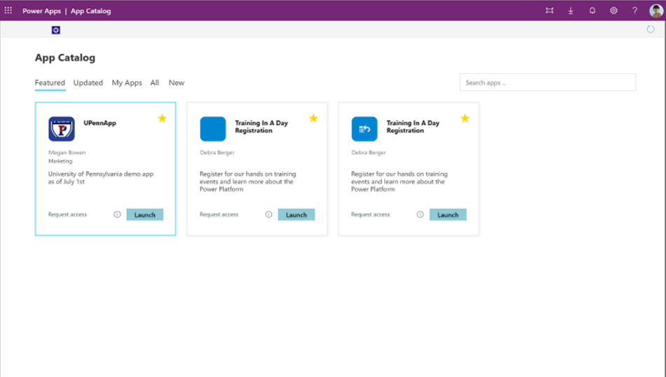
App Catalog
Canvas App
Helps give visibility to certain apps in the organization
Admins can choose which apps to highlight in the app catalog if the app meets admin requirements and is meant to be shared broadly
To publish an app to the app catalog, follow the app auditing process in the Power Platform Admin View app

Slide 37
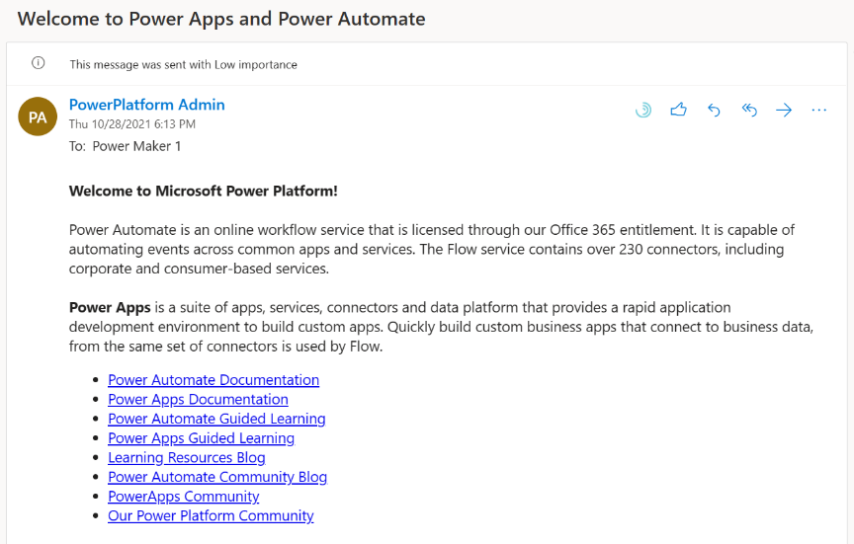
Welcome Email
Sends an email to makers who create an app, flow or connector for the first time
Adds new makers to an Office 365 Security Group

Slide 38
Audit Log Component

Slide 39
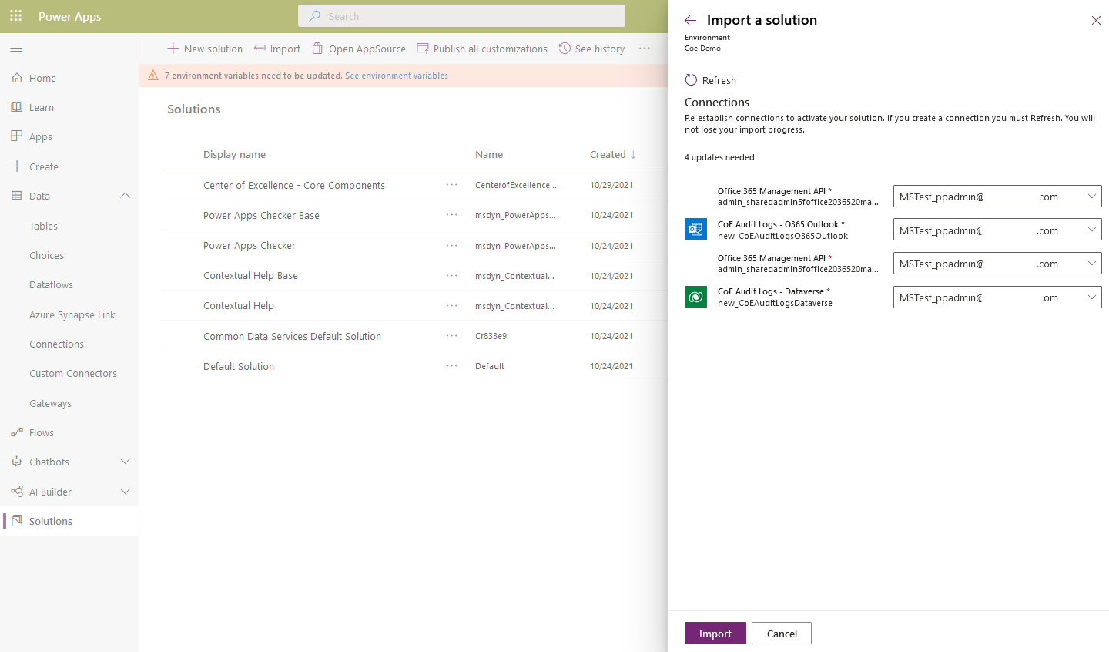
Fetching Power Apps and Flow events from Office 365 Audit Log
Audit Log
Connect to your Office 365 Audit Log (Security and Compliance Center) via a Custom Connector to record following audit events
Launch App
Delete App
Delete Flow
PowerAppPermissionEdited
Using this solution will give you unique user and session data to enable you to identify highly used as well as unused resources

Slide 40
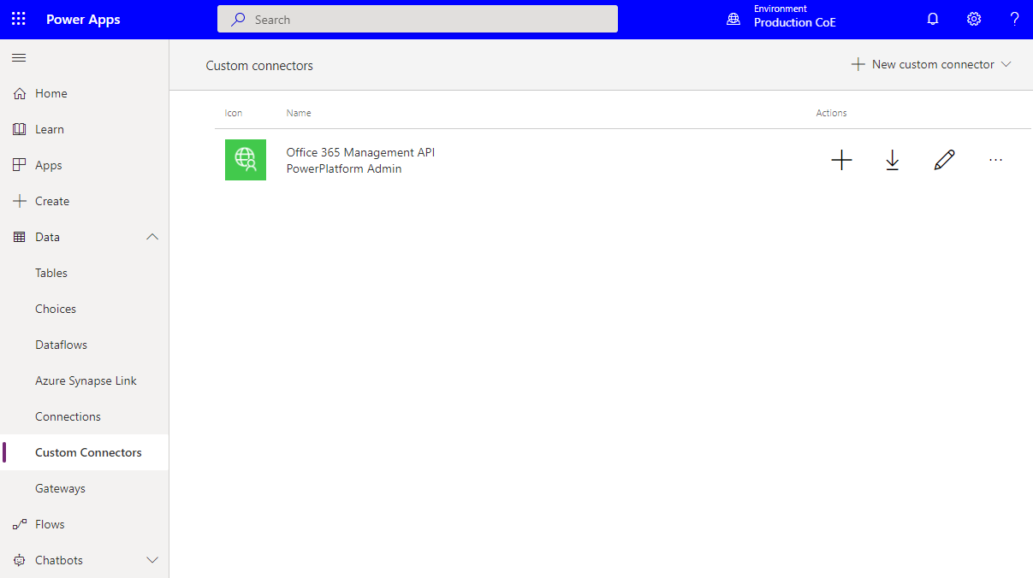
Office 365 Management API
Custom Connector
Office 365 Management API is a custom connector created when Core Solution is imported
Connector uses OAuth (AzureAD App Principal) to connect and access audit logs
Remember to create AAD App Principal and configure custom connector before you import Audit Log solution. See details from HERE

Slide 41
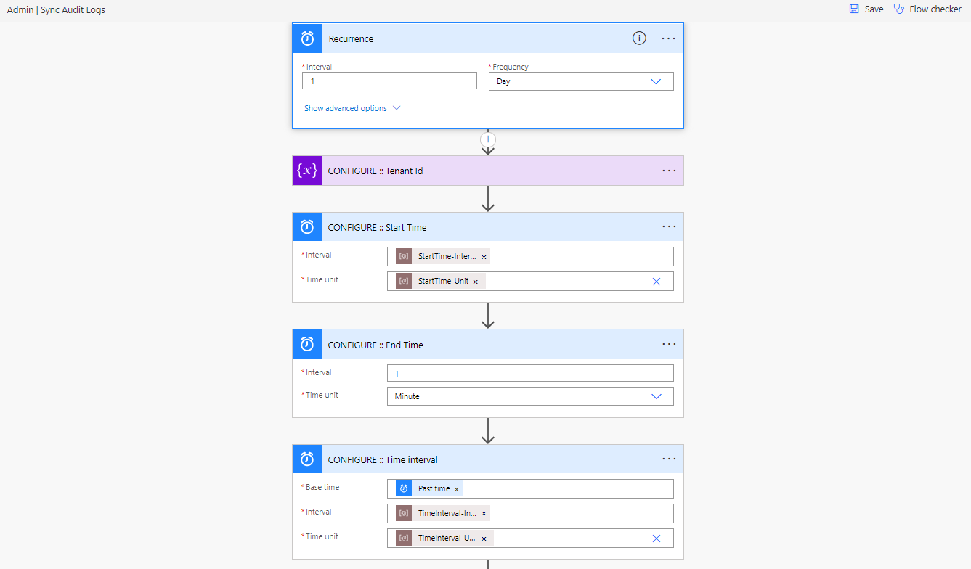
Admin | Sync Audit Logs
Flow
Queries all Audit Log events of specified time range and passes result sets to child flow which will filter and process the wanted Power Platform events
By default, runs once per day and fetches events in 1-hour segments past 24 hours
Default interval and time segments can be changed using environment variables listed in the next slide
See details of setting up the Audit Log components from HERE

Slide 42
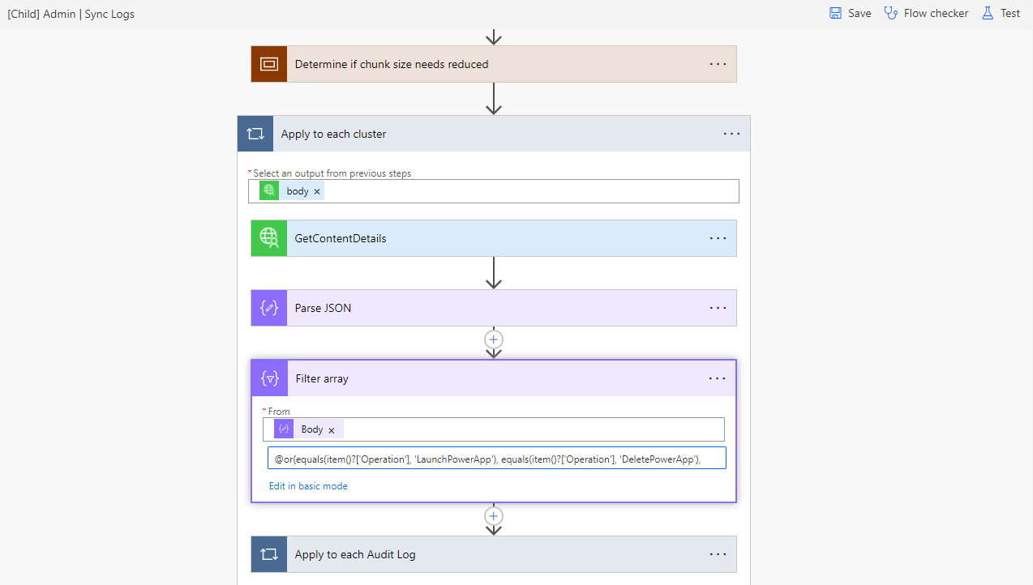
[Child] Admin | Sync Logs
Flow
Child flow processes each segment of events returned from parent flow
Results are paged in 200 events per page by Management API. Child flow does not handle paging and if this happens then admin gets notified and should reduce segment size using Environment Variables

Slide 43
Environment Variables
Name | Description
StartTime-Interval | Must be a whole number to represent the start time for how far back to fetch. Default value: 1 (for 1 day back) and max 7
StartTime-Unit | Determines units for how far back in time to go to fetch data. Must be a value from accepted as an input parameter to Add to Time. Example legal values: Minute, Hour, Day Default value: Day
TimeInterval-Unit | Determines units for chunking the time since start. Must be a value from accepted as an input parameter to Add to Time. Example legal values: Minute, Hour, Day Default value: Hour
TimeInterval-Interval | Must be a whole number to represent the number of chunks of type unit (above). Default value: 1 (for 1 hour chunks)
TimeSegment-CountLimit | Must be a whole number to represent the limit on the number of chunks that can be created. Default value: 60

Slide 44
Power BI Dashboard

Slide 45
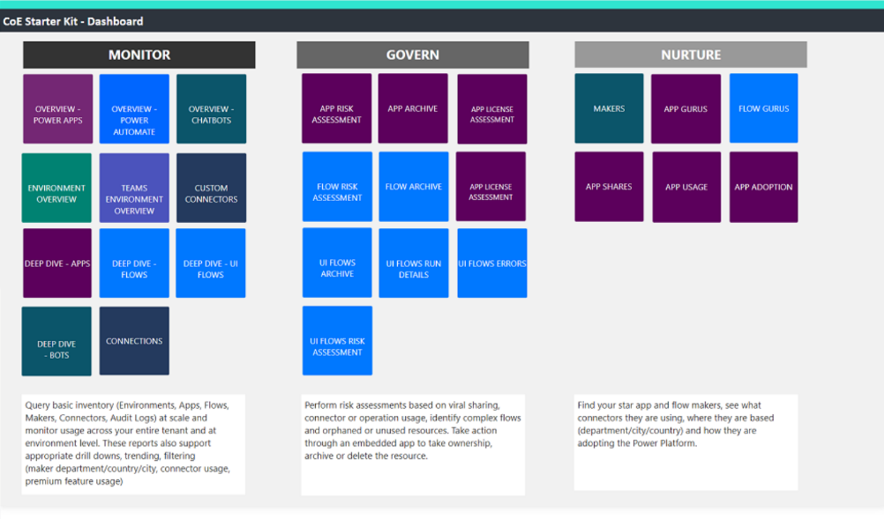
Power BI Dashboard
Provides a holistic view with visualizations and insights into resources in your tenant: Environments, Apps, Flows, Connectors, Connections, Audit Log, Makers etc.
Telemetry from the audit log is stored from the moment you set up the CoE Starter Kit, so over time you can look back and identify trends for longer than 28 days
The dashboard provides analytics and data for the following areas
Monitor - Oversight of tenant resources
Govern - Drive actions through insights
Nurture - Learn about your community

Slide 46
Which dashboard to use?
CoE Starter Kit contains two Power BI template files, one for connecting to Dataverse with the Dataverse connector and one for connecting to Dataverse with Common Data Service (Legacy) connector.
You can use the Legacy_CoEDashboard_yyyyMM.pbit file if you have installed the CoE Starter Kit in a Production environment. This uses the earlier version of the Dataverse connector in Power BI. Use this connector for large datasets that are greater than 80 MB.
You must use Dataverse_CoEDashboard_yyyyMM.pbit if you have installed the CoE Starter Kit in a Dataverse for Teams environment (those don't support Import).
You can also use the Dataverse_CoEDashboard _yyyyMMdd.pbit if you have installed the CoE Starter Kit in a Production Environment, if your dataset is smaller than 80 MB. This version connects to Microsoft Dataverse using the TDS endpoint, therefore the TDS Endpoint has to be enabled for the environment

Slide 47
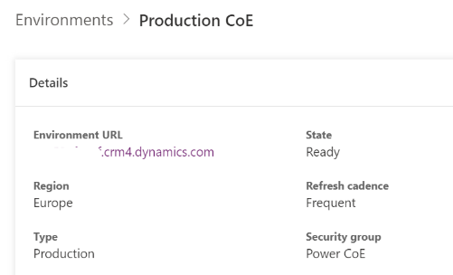
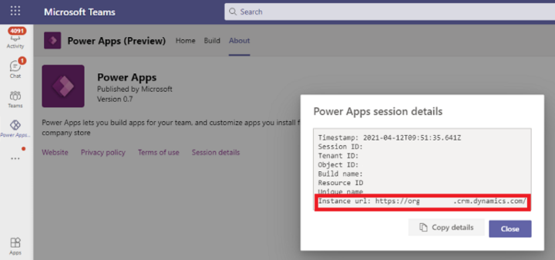
Environment URL
You need the environment URL of the Microsoft Power Platform environment the CoE Starter Kit is installed in. Power BI will connect to the Microsoft Dataverse tables in that environment.
Production Environment URL can be found under the environment page in Power Platform Admin Center. Copy the whole URL with https://
In Dataverse for Teams environment you have to go to Teams Power Apps app, select the Team under the build menu and from About page click Session details. In the opened dialog box you can copy the Instance URL

Slide 48
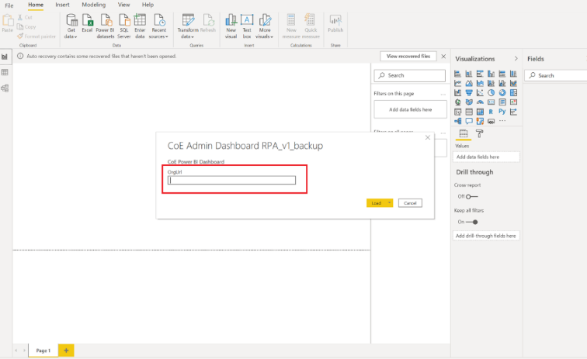
Configure Power BI Dashboard
You can configure and modify the Power BI dashboard by working directly with the Power BI (.pbit) file and Power BI Desktop. This gives you flexibility in terms of modifying the dashboard to your own branding, and including (or excluding) pages or visuals you want to see (or not see) in the dashboard.
Download and install Microsoft Power BI Desktop.
In Power BI Desktop, open the .pbit file, which can be found in the CoE Starter Kit you downloaded from aka.ms/CoeStarterKitDownload.
Enter the URL of your environment instance.
If you are using the Dataverse_CoEDashboard_yyyyMM.pbit, do not include the https:// prefix or / postfix for OrgUrl.
If you are using the Legacy_CoEDashboard_yyyyMM.pbit, include the https:// prefix for OrgUrl.

Slide 49
Report examples of Power BI Dashboard

Slide 50

Overview – Apps, Flows, Chatbots
For Apps, Flow and Chatbots there are Overview pages providing you with a tenant-wide overview of resources:
Total number of environments (and environments created this month)
Total number of environment makers
Total number of custom connectors
Total number of apps, app makers, and apps created this month
Total number of flows, flow makers, and flows created this month
Total number of bots, bot makers, and bots created this month

Slide 51

Environments
The Environments page shows you how many environments, environment makers, and Microsoft Dataverse instances you have.
The graphs visualize:
The environment creation trend by environment type
The number of resources per environment
The number of environments by type
Top environment creators

Slide 52

Microsoft Teams Environments
The Microsoft Teams Environments page shows you the number of Microsoft Teams environments, environment makers, and resources in those environments you have
The graphs visualize:
The environment creation trend
The number of resources per environment

Slide 53
Apps
The Apps page provides an overview of apps in your environment:
Total number of apps
Total number of apps created this month
Total number of app makers
Total number of canvas apps and model-driven apps
The number of production apps (a production app has had 50 active sessions, or active sessions by five unique users, in a month)

Slide 54

Cloud Flows
The Cloud Flows page provides an overview of flows in your environment:
Total number of flows
Total number of flows created this month
Total number of flow makers
Flow creation trends
Top 5 environments

Slide 55

App / Flow Connections
The App & Flow Connections pages shows which resources and makers are using which connectors and—at a high level—which resources and makers are using premium features.
The filters on this page are:
Connector tier (premium or standard)
Connector (e.g. Office 365 Users, Dataverse, Azure AD etc.)

Slide 56

App and Flow Risk Assessment
You can use the dashboard to identify overshared and overused resources, or resources that use specific connectors.
Not only will you have visibility to those types of resources, you can grant yourself ownership to inspect the resource behavior and decide whether you need to take further action.
Identify widely shared apps/flows
Identify orphaned apps/flows
Identify implicitly shared app/flow connections
Notes:
Identify implicitly shared app connections
Some connectors, like the SQL Connector used with SQL Server Authentication, are shared implicitly with users. This means that as soon as the app is published, the connection is also published and available to your users. Your users can then also create apps by using any connection that uses SQL Server authentication that's shared with them.
Identify apps that use the SQL Server Connector. Ensure that users are aware of the risks, and help them mitigate it by enabling Azure AD authentication for SQL Server.

Slide 57

App License Assessment
You can use the App license assessment page to view apps that use premium or standard features and drill down into connectors, departments or makers that are using premium connectors.

Slide 58

App, Flow and Desktop Flow Archive
Identify unused apps, flows and desktop flows by monitoring their archive score: in short, the higher the score, the more likely it is that you can safely archive the resource.
The highest possible score for an app is 8. Max score represents an app that hasn’t been never modified, is using word like test or demo in the title, was created over three years ago and is likely created from a template
The highest possible score for a flow is 11. Max score represents a flow that hasn't been modified since it was created, is using word like test or demo in the title, was created over three years ago, was likely created from a template, is suspended, is orphan and isn't complex (contains fewer than five actions).
The highest possible score for a desktop flow is 6. A score of 6 represents a desktop flow that hasn't been modified since it was created, is using word like test or demo in the title, was created over a year ago, and was likely created from a template.

Slide 59
Power BI Dashboard - Compliance and Adoption

Slide 60

Compliance and Governance Dashboard
The Compliance and Governance insights page provides you with a tenant-wide overview of:
Apps and flows without an owner
Apps and flows not in solutions
Apps and flows with duplicate names
Apps and flows with test, demo, template in the name
Apps and flows with open compliance details requests
Apps currently not compliant with DLP policies or billing policies
Grandfathered apps
Apps shared with everyone and apps shared with more than 100 users
Apps not launched in the last month and in the last quarter
Suspended flows
Flows using plain text passwords
Cross-tenant connections
Environments with no apps or flows

Slide 61

Apps Drill Through
From each card, you can drill-through to a list of apps matching the selected criteria

Slide 62

Flows Drill Through
From each card, you can drill-through to a list of apps or flows matching the selected criteria

Slide 63

Adoption insights Dashboard
The Adoption insights page provides you with a tenant-wide overview of:
Apps launched this month and this quarter
Unique users in the past month
Total makers
Top 5 connectors used in apps and flows
Top 5 most launched apps
Top 5 makers with the most launched apps
Top 5 countries where makers create most launched apps
Top 5 environments that consume the most capacity

Slide 64

Default environment Dashboard
The Default environment page gives you an overview of adoption in the default environment, with the intent to help clean up tech debt in this environment and highlight highly adopted resources that may need to be migrated to a production environment.
Apps and flows without an owner
Apps currently not compliant with DLP policies or billing policies
Grandfathered apps
Apps shared with everyone and apps shared with more than 100 users
Suspended flows
Flows using plain text passwords
Top 5 most launched apps
Top 5 most shared apps
Latest non-compliant apps
Latest suspended flows

